Slide 1
Blogging for Business 101
The what, when and how of using blogging to take your business to the next level
Brought to you by:

Slide 2
Brief Introduction

Slide 3
Brief Introduction
Tracy Marlowe,
Partner and Director of Account Services
Creative Noggin
Full service, branding, advertising and communications company
www.creativenoggin.com
Musings of the Creative Noggins (our blog)
http://blog.creativenoggin.com

Slide 4
What we’ll cover today
Blogging stats
What to consider before you get started
Benefits of blogging
How to get started
Posting (who, what, when, etc.)
Blog Promotion
I have a blog! Now what?

Slide 5
Blogging Stats
Technorati, State of the Blogosphere 2008
(published in Sept 2008)
133 million blog records indexed by Technorati since 2002
7.4 million blog posts in last 120 days
900,000 blog posts in 24 hours
120,000 new blogs started every day (or 1.4 new blogs every second)

Slide 6
Blogging Stats
Blogs are a part of our daily lives. The numbers vary but all agree that blogs are here to stay:
96.6 million US blog readers in 2007 (48.5% of Internet users)
27.9 million US bloggers in 2007 (14%)
Projected 128.2 million readers in 2013 (58%)
source: eMarketer (April 2009)

Slide 7
Blogging Stats
“The word blog is irrelevant, what’s important is that it is now common, and will soon be expected, that every intelligent person (and quite a few unintelligent ones) will have a media platform where they share what they care about with the world.”
–Seth Godin, Foremost blogger
His blog is: Seth’s Blog at sethgodin.typepad.com
#18 in the top 100 blogs on Technorati and
Author of the bestselling book “Tribes”

Slide 8
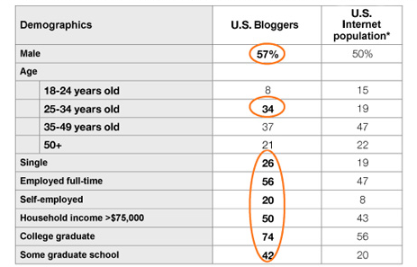
Blogging Stats
U.S. Bloggers are more educated and affluent than the general Internet population
As compared to the general Internet population, U.S. bloggers are more male, single and employed full-time
Source: ComScore Plan Matrix, July 2008

Slide 9
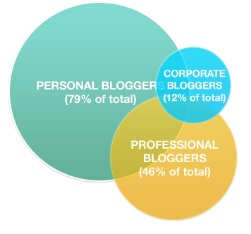
Blogging Stats
Corporate Bloggers:
69% are also professional bloggers
65% are professional bloggers
Professional Bloggers:
59% are also personal bloggers
17% are corporate bloggers

Slide 10
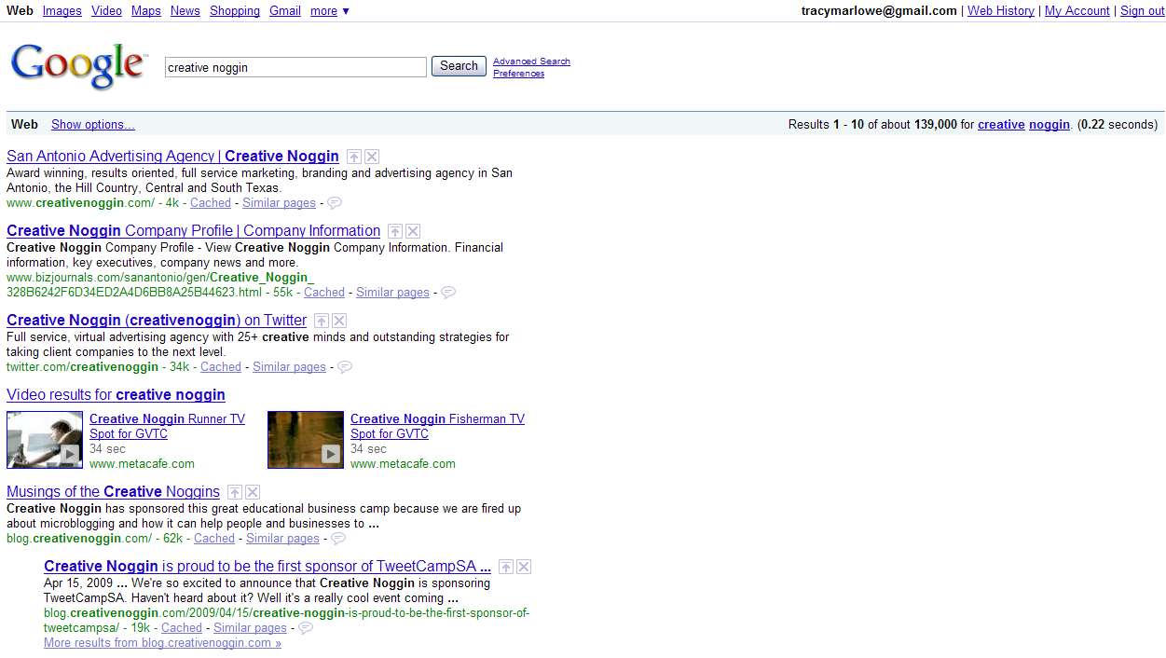
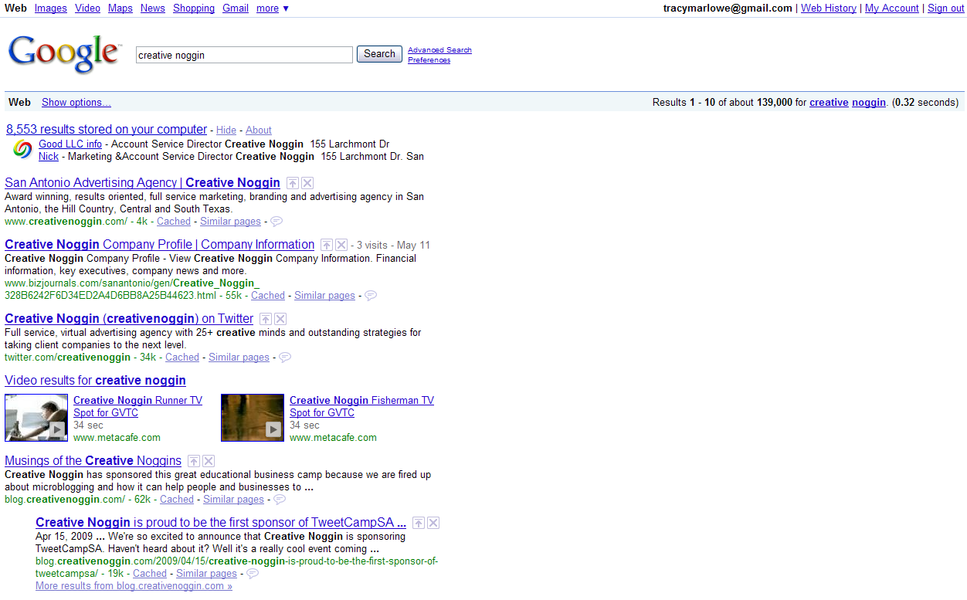
Blogging Stats
Are you reading blogs and you don’t even realize it?
These are all blog results

Slide 11
Before you get started
What do you need to consider?
Do you have the resources?
What are bloggers saying about your industry?
What will you focus on?
How will you keep it customer centric?
How will you keep in-synch with your companies communication strategy?
What will your comment policy be?
Are you prepared to be patient?

Slide 12
Before you get started
Do you have the resources?
How many people can write?
How much time can they commit?
Goal: minimum of 2-3 posts per week (ideally three)

Slide 13
Before you get started
What are bloggers saying?
About your company?
Your products/services?
You competition?
Any company spokespeople in the press?
Even if you decide not to launch a blog, it’s still good to stay in the loop with what bloggers are saying and respond to their comments.

Slide 14
Before you get started
What’s your blog’s focus?
To build company awareness?
As a customer service tool?
As a customer forum?
What is your goal? What is important to your customer? How can you meld the two?

Slide 15
Before you get started
How will you create customer centric content?
Do NOT view your blog as a self promotion channel
Use your blog to indirectly promote your company
Examples:
Graco
Dell
Starbucks

Slide 16
Before you get started
How will you mesh blog strategy with overall company communications strategy?
Blog is long-term; not quick campaign
MUST be in-line with company strategy and brand platform

Slide 17
Before you get started
What will your comment strategy be?
Will you moderate?
If so, who approves?
Who replies?
Which will be allowed and which deleted?

Slide 18
Before you get started
Are you willing to be patient?
Results won’t happen overnight
Must be consistent and dedicated for months and years to see true incremental results
Think marathon, not sprint

Slide 19
Benefits of blogging
Still interested? If so, here’s how a blog can help your business:
Establish Credibility
Increase your SEO
Build a Community
Know your Market
Low Cost/Web Publishing Solution

Slide 20
Benefits of blogging
Establish Credibility
Help prospects sell themselves
Answer top of mind questions
Educate your market and establish yourself as an expert

Slide 21
Benefits of blogging
Increase your SEO
A HUGE percentage of your blog traffic could come from search engines, especially Google
Tailor your content for SEO
Include keywords and phrases
Control the key elements that search engines crawl for (I’ll show you how to do all of this later in this presentation)

Slide 22
Benefits of blogging
Build a community
Share knowledge with large audience
Captivate people who share those interests

Slide 23
Benefits of blogging
Better know your market
Use Technorati or other search engines to find relevant blogs and posts
Read, read, read
Keep an open mind

Slide 24
Benefits of blogging
Low cost marketing and web publishing
Many free blog platforms
All it costs you is time
Extremely low cost compared to traditional advertising with tremendous potential for ROI

Slide 25
How do I get started?
Pick your blogging platform
Design
What elements to include
Pitfalls to avoid

Slide 26
How do I get started?
Pick a free blog platform
Blogger.com
Typepad.com
Wordpress.com

Slide 27
How do I get started?
“Create” your design layout
Use free templates
Pick one and go with it; don’t over think this
If you want something cool, go back and update later

Slide 28
How do I get started?
Don’t over “widget”. Here’s what you need:
Subscriber button to RSS feed
List of links
Recent posts
About section or page

Slide 29
How do I get started?
Once you have a few posts under your belt, add:
Archives
Tag cloud or categories

Slide 30
How do I get started?
Do NOT:
Wait until you get it “perfect” to launch
Use the platform subdomain (i.e. creativenoggin.wordpress.com); create your own domain
Keep your blog a secret
Monetize

Slide 31
Posting
Who should write your posts?
What do you write about?

Slide 32
Posting
Who should write your posts?
Who is best suited to connect with your audience?
Single spokesperson writer?
Or collaboration?
Or customers?

Slide 33
Posting
What do you write about? All posts should:
Be customer centric
Have personality
Be brief
Provide unique info
Educate, inform and discuss
Give people a reason to come back

Slide 34
Posting
What not to do in your posts:
Don’t use corporate jargon
Make your blog a corporate brochure
Use stilted language
Ignore comments
Provide self serving info; focus on your customer

Slide 35
Posting
Sample post topics:
Come up with a unique angle focused on your customer
Highlight your clients success stories
Link to prospects blogs if relevant
Build a community for current customers as well as prospects
Be a resource
Provide exclusive tips and info
Invite customers to write guest posts
Be sure to ask for comments/feedback on every post!

Slide 36
Blog Promotion
How do I get traffic?
SEO
Social Media
Internal links
Blog directories
Read blogs and comment
Pitch the press

Slide 37
Blog Promotion
SEO
ID your keywords
Use Google or Yahoo keyword tool
Keep the long tail in mind

Slide 38
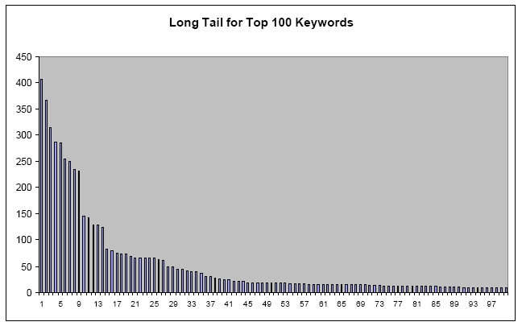
Blog Promotion
General phrases, high search volume, difficult to rank for
More specific phrases with lower search volume but easier to rank for; prospects are easier to close

Slide 39
Blog Promotion
Selecting keywords
Start with long tail, lower volume word/phrases
But include high volume phrases in content and occasionally so you will build for these over time
Make a list and prioritize

Slide 40
Blog Promotion
Where do I put these keywords?
In the title
In the url
The first sentence of post
Photos/media

Slide 41
Blog Promotion
Promote your blog using email
Announcement email
Monthly emails/newsletters
Event emails
Emails to certain prospects with posts relevant to them

Slide 42
Blog Promotion
Social Media
Facebook
LinkedIn
Twitter
Digg
Stumble Upon
FriendFeed

Slide 43
Blog Promotion
Internal links
Link within your blog posts to other posts that are relevant

Slide 44
Blog Promotion
Blog Directories
Technorati
Blog Catalog
Hundreds of others http://www.toprankblog.com/rss-blog-directories/

Slide 45
Blog Promotion
Continue to read, read, read!
Visit high traffic blogs with relevant info
Leave comments
Build relationships with other bloggers

Slide 46
Blog Promotion
Pitch to the press
If you’re doing something really unique, pitch the story to the press

Slide 47
Now what?
Watch traffic, see what works, repeat
Tools for tracking traffic: www.budurl.com
www.statcounter.com
Keep posting and commenting
Be patient

Slide 48
Great blogs to read
Chris Brogan www.chrisbrogan.com
Seth Godin http://sethgodin.typepad.com/
Alan Weinkrantz http://alanweinkrantz.typepad.com/
Mack Collier http://moblogsmoproblems.blogspot.com/
Blogs of Newspapers and Reporters:
San Antonio Express News
SA Chronicle
BusinessWeek

Slide 49
Thank you!!

